Slide 1
ME 476C Final Presentation
Renewable Energy Project
Michael Horn, Garrett Cornelius, Nicholis Santana & Issac Granados

Slide 2
Project Description
Background:
Private party off grid cabin to be constructed by Winiecki family
Construction plans are already in place
Site location established
APS power will be connected
Hybrid Solar System
Project Goals:
Analyze solar photovoltaic systems for off grid application
Model estimated energy load / consumption of the Winiecki off grid cabin
Test energy demands of cabin
Optimize solar system for maximum efficiency
Implement and install selected solar design
Michael Horn
04/26/23
Renewable Energy

Slide 3
Prototyping
Renewable Energy Lab Solar Panel Testing
  Old array deconstructed
  New solar panels installed, wired, and tested successfully
  Inverter is receiving enough power to test functionality
GridZero Application
  Special Inverter setting which utilizes hybrid solar PV with no grid feedback
“Hands-on” experience
Michael Horn
04/26/23
Renewable Energy

Slide 4
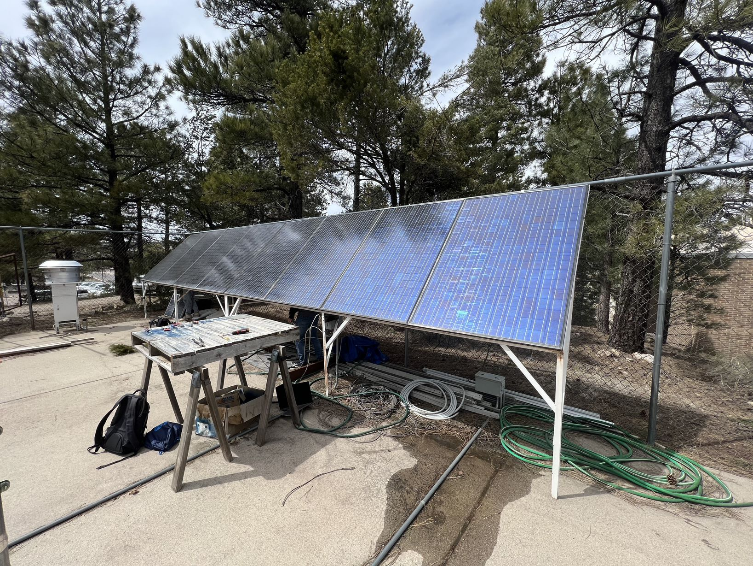
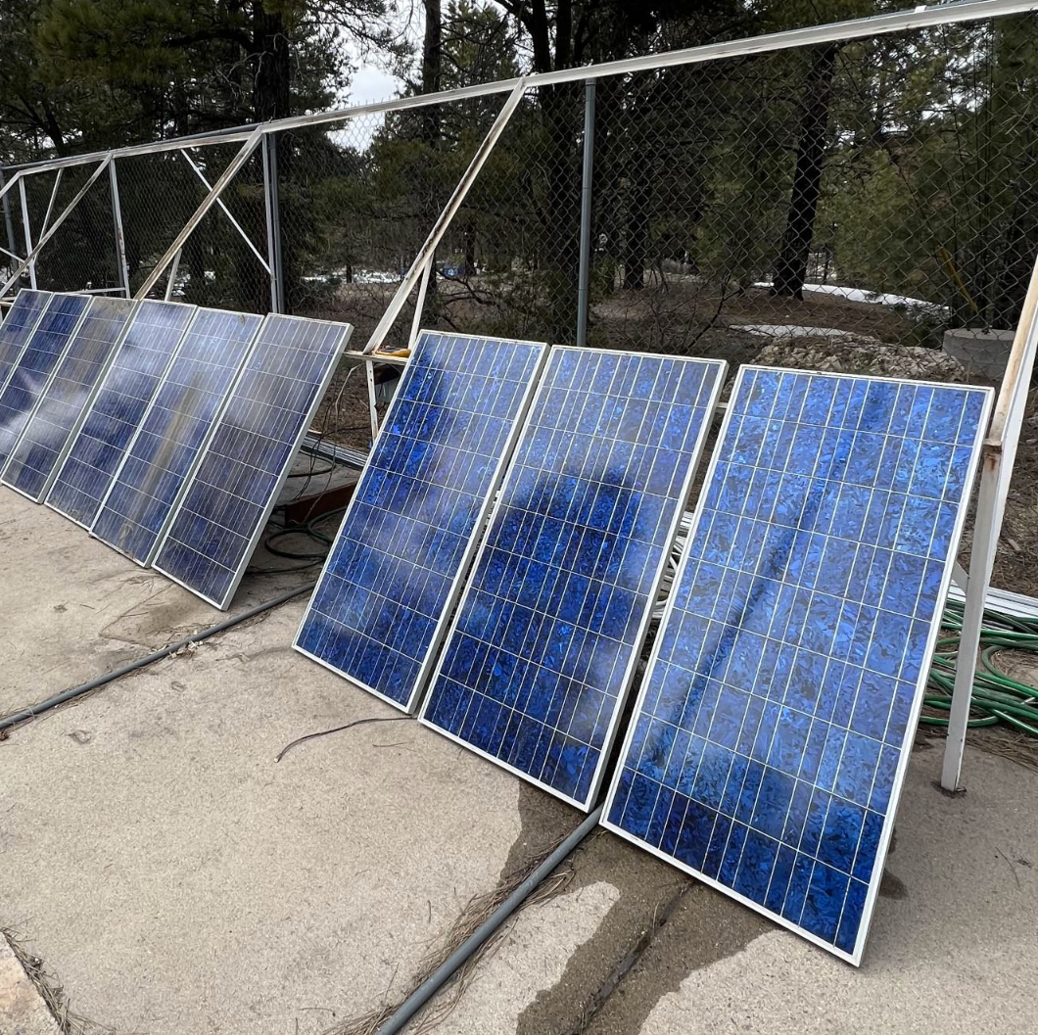
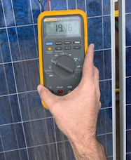
Prototyping Photos
Figure 1: Old Panel Array
Figure 2: New Panel Array
Figure 3: New Array Voltage
Michael Horn
04/26/23
Renewable Energy

Slide 5
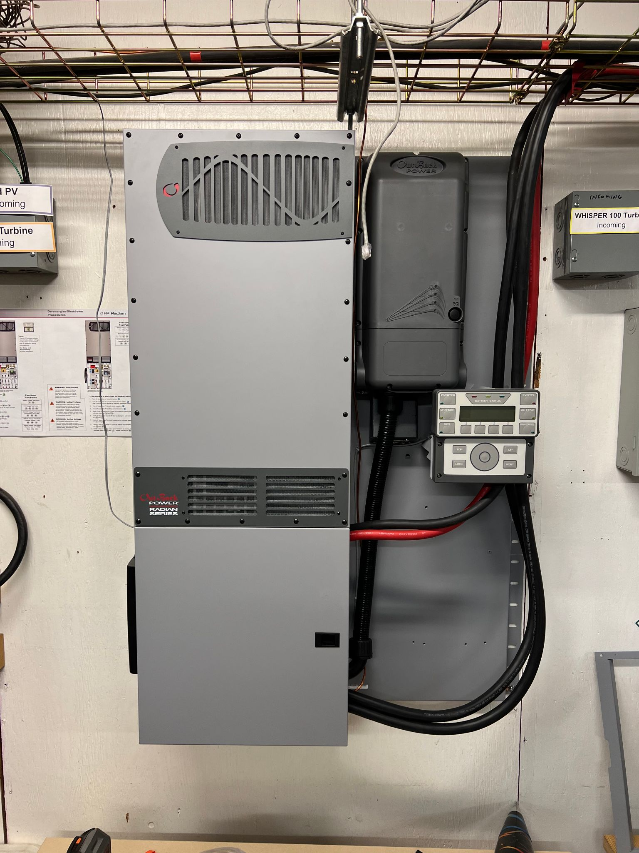
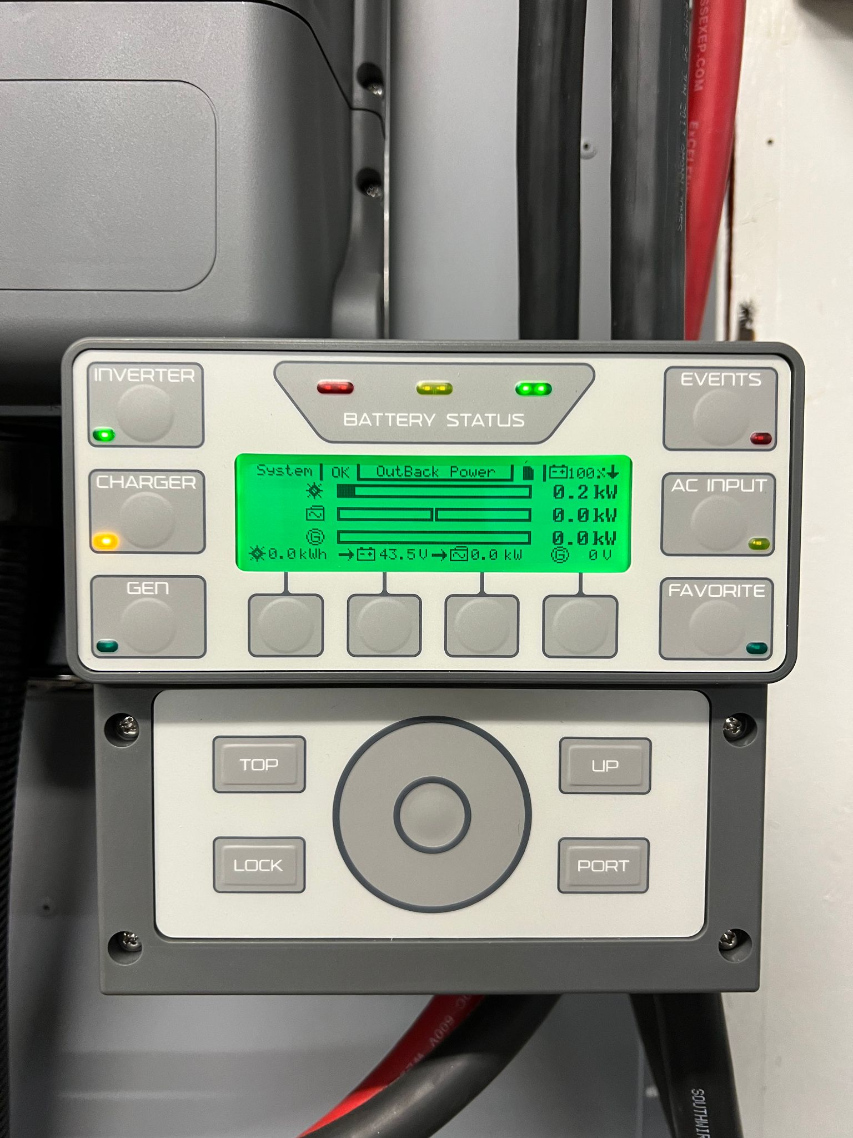
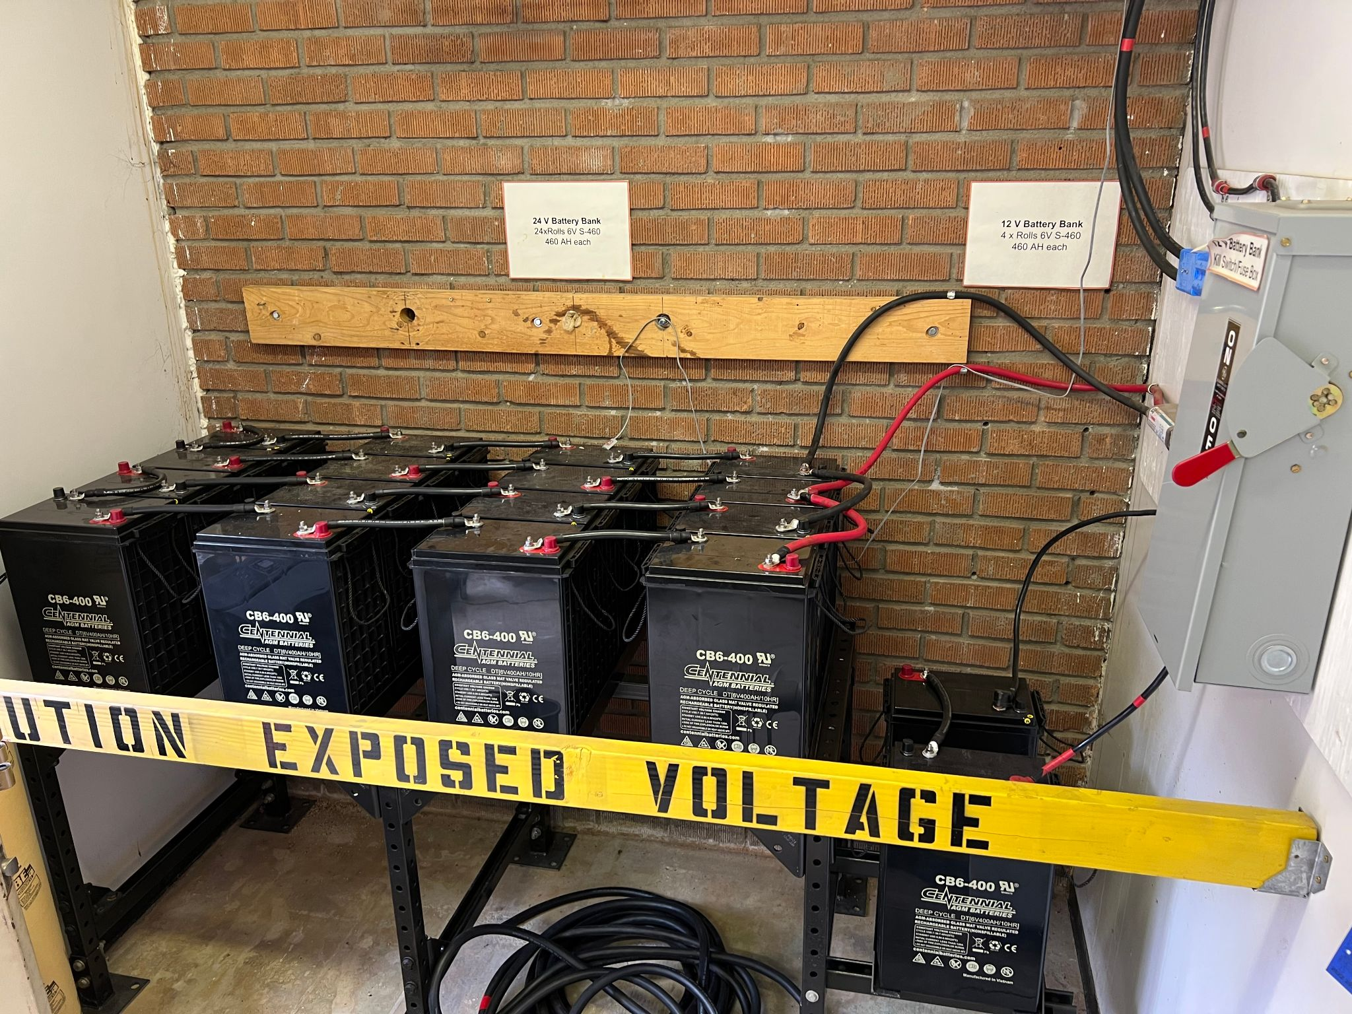
Prototyping Photos
Figure 4: Inverter System
Figure 5: System Monitor
Figure 6: Battery Bank System
Michael Horn
04/26/23
Renewable Energy

Slide 6
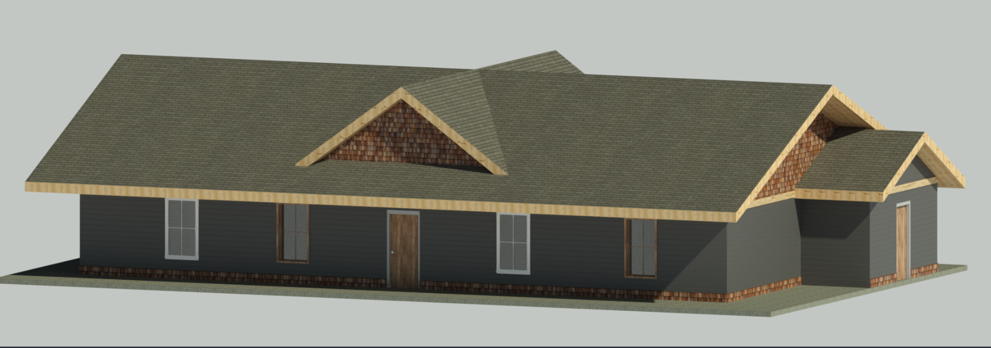
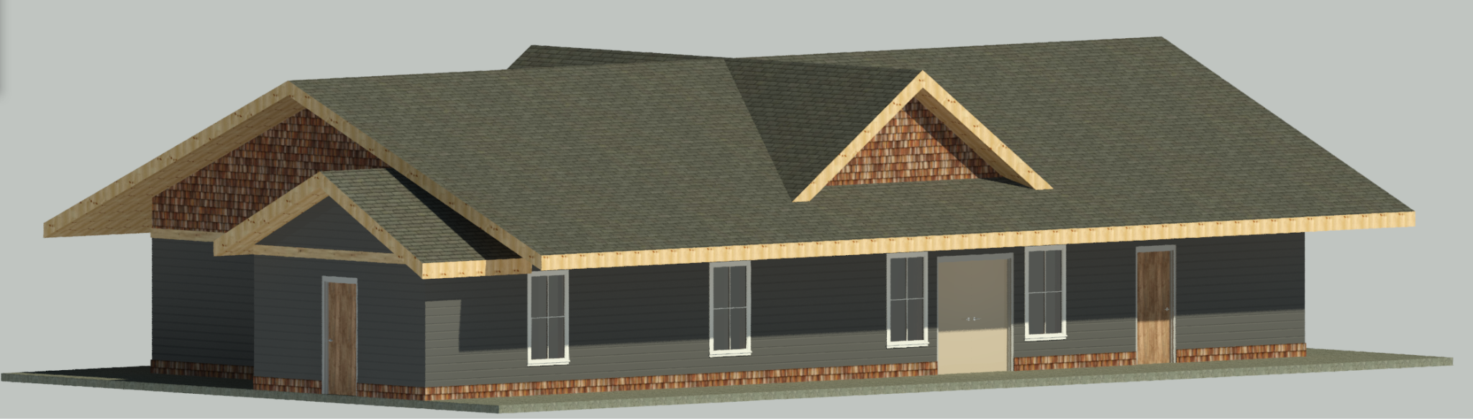
Energy Model (CAD Package)
AutoDesk Revit Rendered Drawings
Figure 7: Front Render
Figure 8: Rear Render
Garrett Cornelius
04/26/23
Renewable Energy

Slide 7
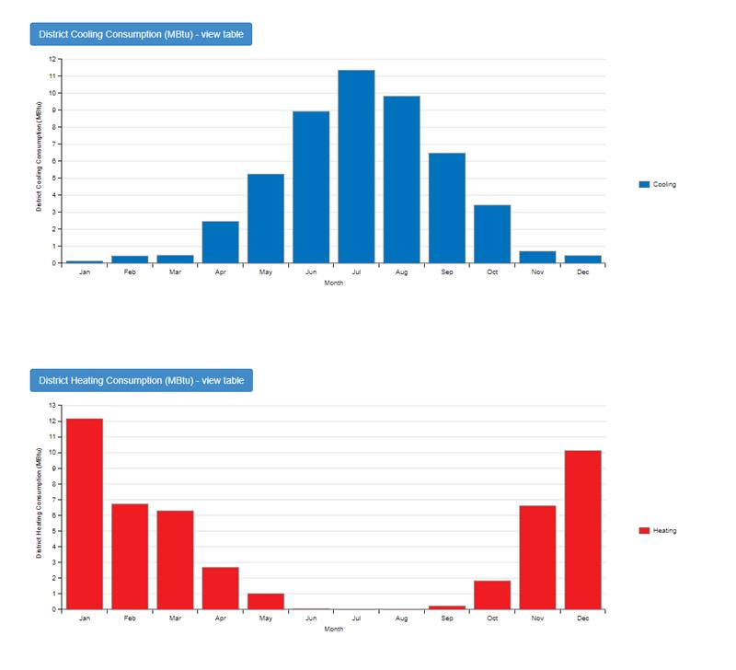
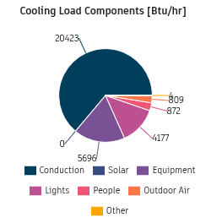
Energy Model Results
Figure 10: Cooling Load Pie Chart
Garrett Cornelius
04/26/23
Renewable Energy
Figure 9: Monthly MBTU Result

Slide 8
Energy Model Results Cont.
Monthly Energy Consumption: 1200 kWh - 1400 kWh per month
Yearly Energy Consumption: 15,500 kWh per year
Moving Forward:
Adapt System Scale to meet expected needs
Continue to improve accuracy of model
  Analytical analysis
  Material and design updates
Garrett Cornelius
04/26/23
Renewable Energy

Slide 9
Design Description
Major Components
Solar Panels
  Panels provide DC electricity to inverter
Grid Source
  Grid energy is sent to main panel, which is connected to the inverter
Batteries
  Batteries store electrical energy
  Connected to inverter
  Can be charged by grid or solar power
Inverter
  Heart of the system: Inverter controls all electrical inputs and outputs
  Utilizes ‘GridZero’ function: energy will be sent from corresponding sources to optimize the system at all times
Complementary Components
  Charge Controller - Electromechanical device which optimizes battery charging; seeks out max charge from PV system to charge batteries
  Inverter Interface - Allows user to interact with inverter
Michael Horn
04/26/23
Renewable Energy

Slide 10
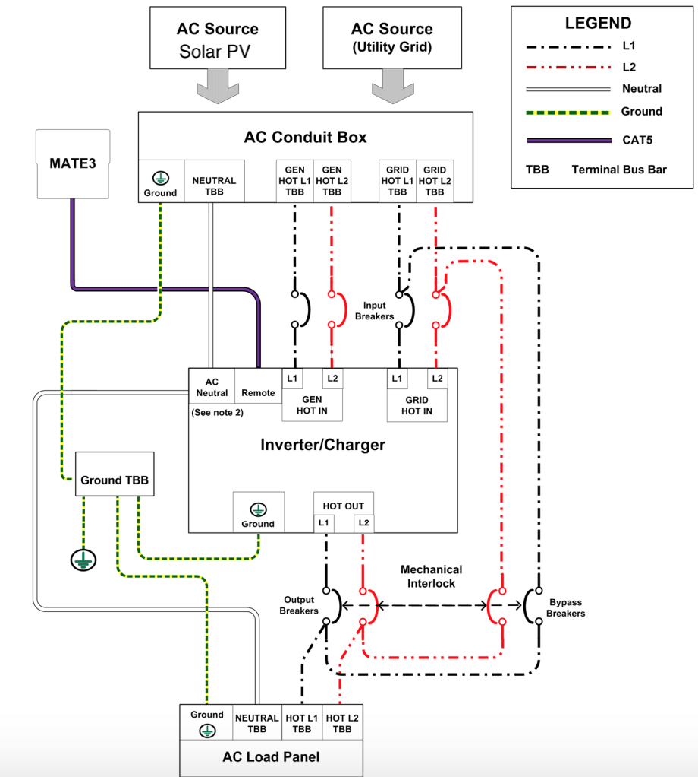
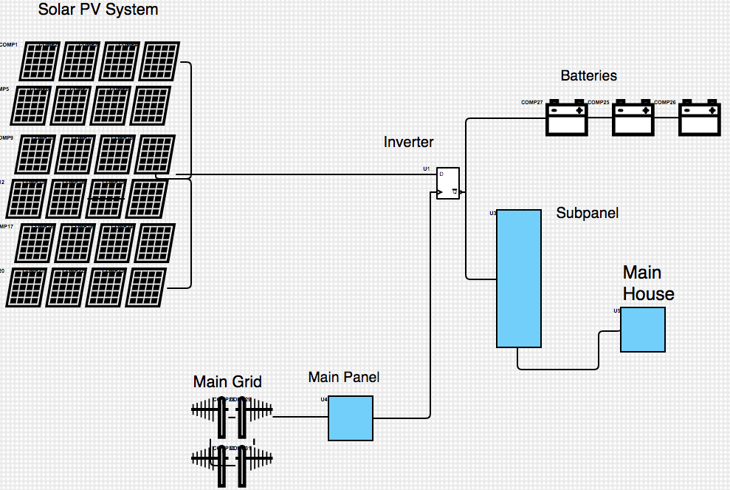
Design Description
Current System Design
Figure 11: Basic Hybrid Solar Electrical Diagram
Figure 12: Hybrid Solar Diagram Detail
Reference: Outback Radian Series Manual
Michael Horn
04/26/23
Renewable Energy

Slide 11
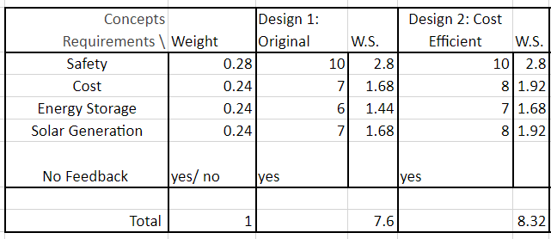
Design Requirements
* Safe to operate - 5
* Cost Efficient - 3
* Large Storage System - 4
* Solar Generation Heavy - 5
* Reliable/Adaptable Design - 4
Design 2
Panel Type: Trina Tallmax TSM-DE15V
Cost, Efficiency
Battery System: Kong Elite
Cost, Expectation
Tilt Angle: Fixed
Cost, Durability
Issac Granados
04/26/23
Renewable Energy

Slide 12
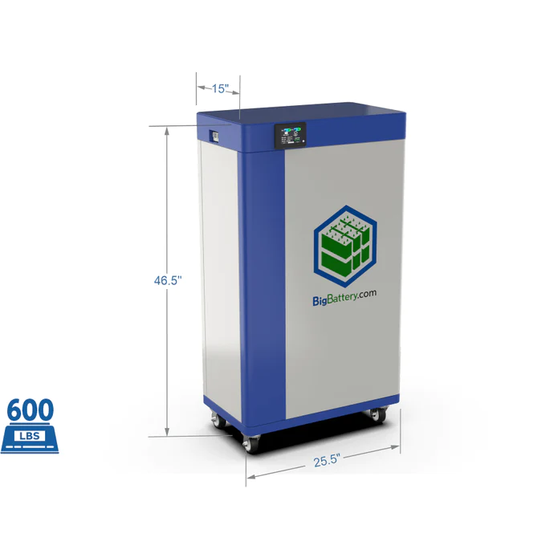
Battery System
Assumptions:
Customer Usage: 42 kWh/day
Recommendation: 28.8kWh/day
2 batteries
2-3 day lifespan
Minimum: 14.4kWh/day
1 batteries
1 day lifespan
Maximum: 43.2kWh/day
3 batteries
3 day lifespan
Figure 13: Kong Elite - 48V, 300Ah, 15kWh
Issac Granados
04/26/23
Renewable Energy
Notes:
All calculations are with batteries in series

Slide 13
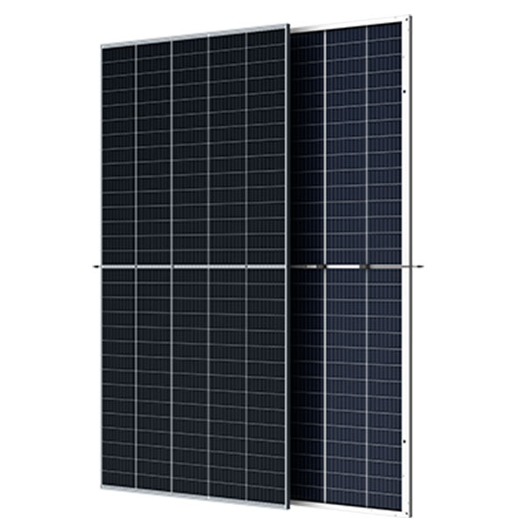
Solar Generation
Assumptions:
Average 65% efficiency
11:30-2:30 peak sun hours
Average 30% efficiency
6:30-11:30 and 2:30-5:30
Calculations:
480W*.65*3 hours*19 panels
480W*.3*8 hours*19 panels
50 kWh being generated daily will exceed the monthly need
Recommended: 48 kWh
23 Panels
Minimum: 39.7 kWh
19 Panels
Maximum: 50 kWh
24 Panels
Issac Granados
04/26/23
Renewable Energy
Figure 14: Trina Tallmax TSM-DE15V
Notes:
Under terrible conditions: cloudy 21 panels produce 33.3 kWh, 23 panels produce 36.4 kWh, 24 panels produce 38.0 kWh
14352+33120=47472
13104+30240=43344 } 2 peak sun hours
14976+34560=49536
21888+17784
2 and a half days at full power

Slide 14

Inverter (Manual)
Min and Max
Minimum of 100 Amps to start
Voltage needs to be in the range of 12.2 to 59.7 volts
Additional Features
Multiple modes based on the solar generation (snooze, active, slave, etc.)
Automatically switches between solar power bank to grid tied electricity
Figure 15: Outback Radian 4048
Issac Granados
04/26/23
Renewable Energy

Slide 15
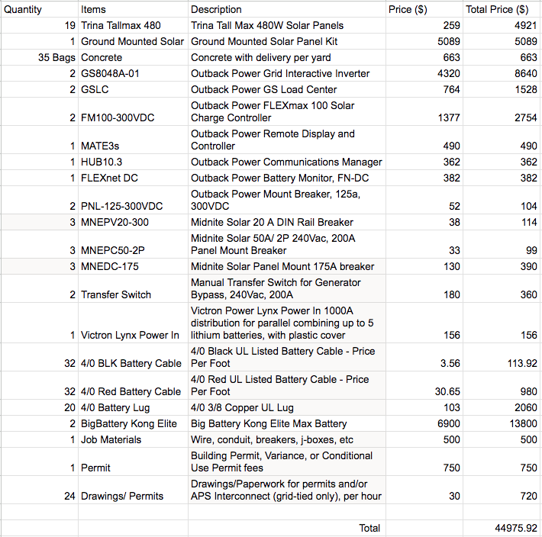
Bill of Materials
Issac Granados
04/26/23
Renewable Energy
Figure 16: Final Design BOM

Slide 16
Design Validation
Individual Analysis will highlight flaws and validate proposed solutions
Structural Analysis
  Analyzing the structural stability of ground mounted panels
Energy Optimization
  Determining modes of optimization for maximum efficiency
Energy Storage Analysis
  Analyzing expected energy storage considerations
Energy Production and Consumption Analysis
  Analyzing expected loads with respect to energy generation
Issac Granados
04/26/23
Renewable Energy

Slide 17
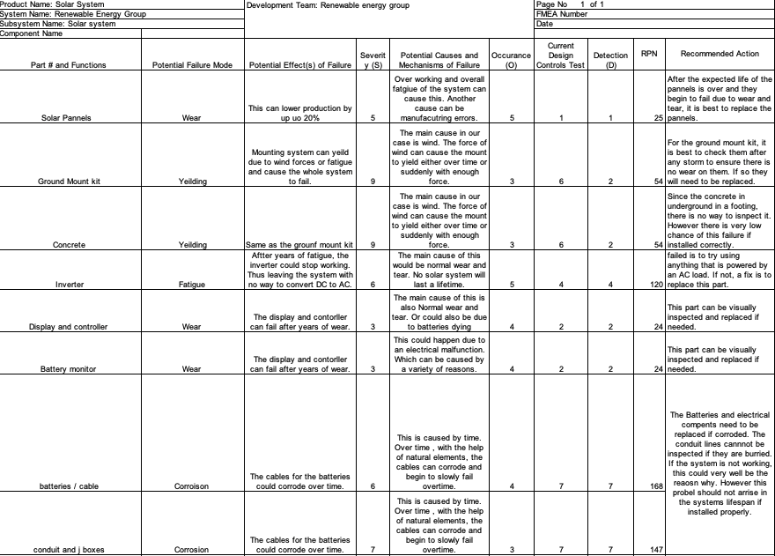
Nicholis Santana
04/26/23
Renewable Energy

Slide 18
Design Validation
Planned Testing Procedures
House Construction planned completion before 486C start
Measure exact electrical usage and generation
  Large scale meter to measure values over a period of weeks.
Compare Energy Model Results with Actual
Nicholis Santana
04/26/23
Renewable Energy

Slide 19
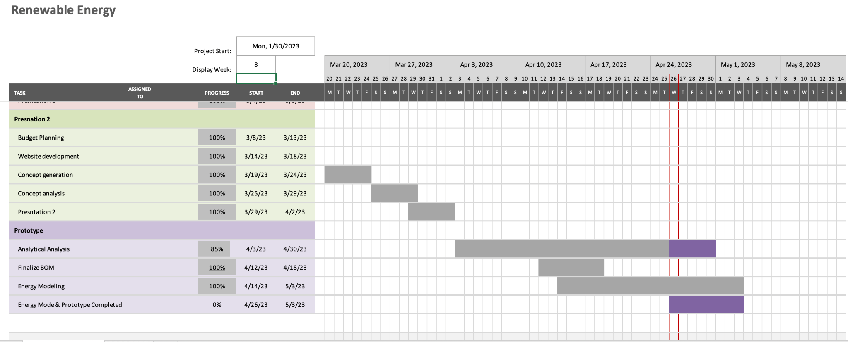
Schedule
Nicholis Santana
04/26/23
Renewable Energy

Slide 20
Moving Forward
House construction still planned for this summer, Site Visits Recommended
Ongoing Energy Model Updates and PV system simulations
Continuing efforts with REL to gain comfort with PV system programming
Preparation for 486C deliverables shown in “look-ahead”
Nicholis Santana
04/26/23
Renewable Energy

Slide 21
486C Task Look-Ahead
Major Tasks | Obligated Members
PV System Construction (after construction) Testing Plan (9/23) Operation/Assembly Manual (11/23) Final CAD Packet (12/23) Final Report (12/23) | Whole-Team Issac (Test Lead) Michael H and Nicholis S Garrett (CAD Lead) Whole Team
Minor Tasks | Obligated Members
Project Management Self Learning/Individual Analysis Website Checks #1 and #2 Poster Design Presentations 1 - 5 Client Handoff | Michael H (PM) Whole Team Garrett C (CAD Lead) Nicholis S (LM) Whole Team Whole Team
Garrett Cornelius
04/26/23
Renewable Energy

Slide 22
References
https://s3.amazonaws.com/zcom-media/sites/a0i0h00000KyCXiAAN/media/mediamanager/OutBack_Radian_4048A_8048A_Inverter_manual.pdf

